Slide 1
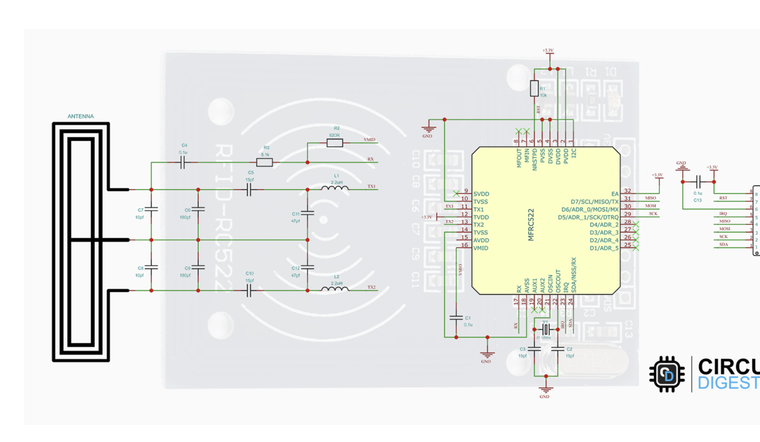

Slide 2
https://circuitdigest.com/microcontroller-projects/interfacing-rfid-reader-module-with-arduino
https://github.com/miguelbalboa/rfid/issues/43

Slide 3
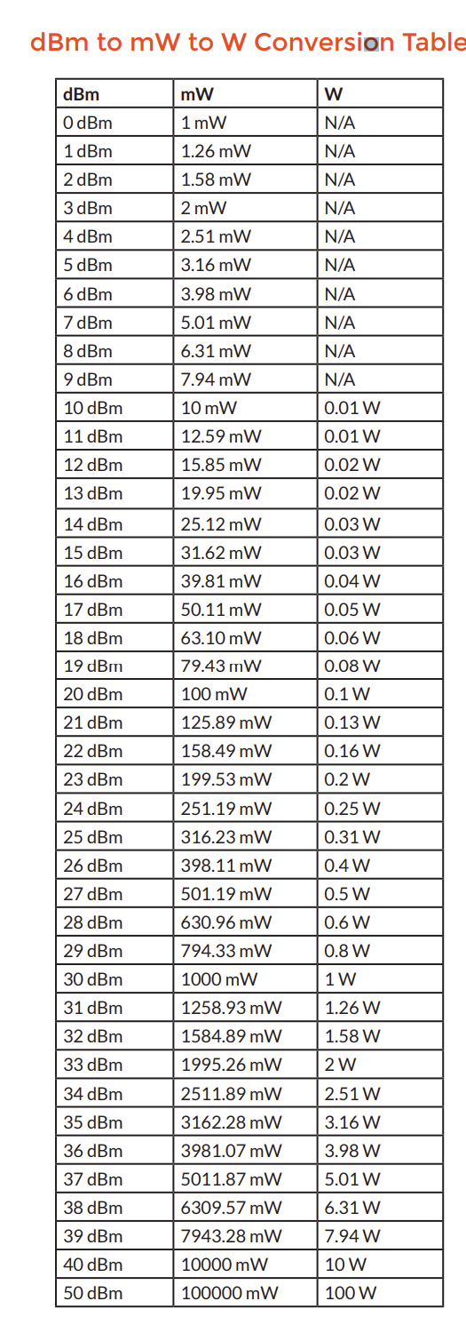
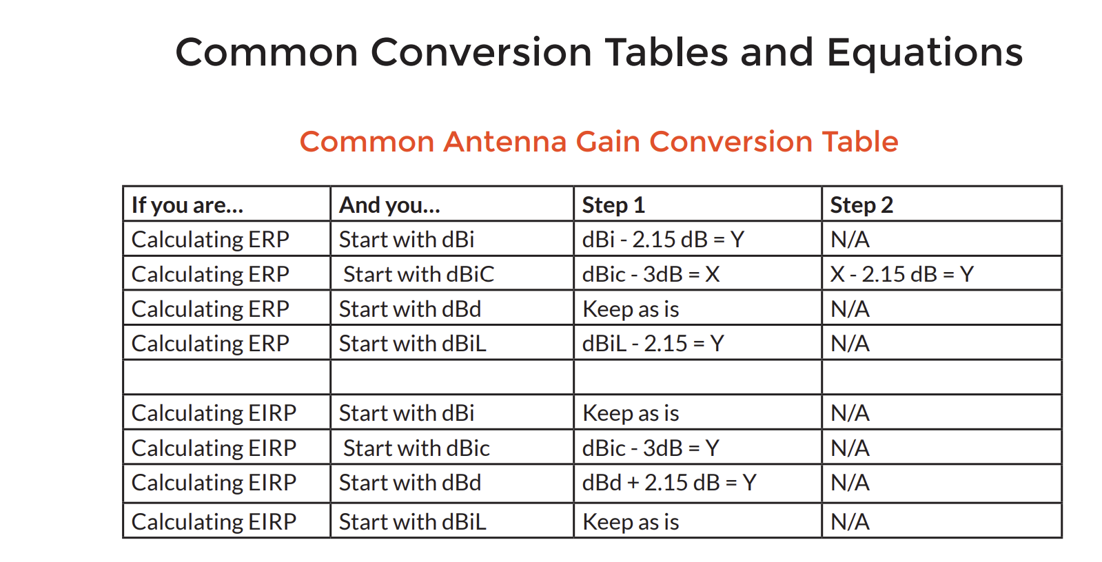

Slide 4


Slide 5
MFRC 522 seems like power is too low
STM3916 may be a better option, and it’s the same chip that drives the X-NUCLEO board
https://github.com/stm32duino/ST25R3916
https://eds.st.com/nfc-tuningcircuit/
https://www.st.com/en/nfc/st25r3916.html?rt=um&id=UM2615

Slide 6
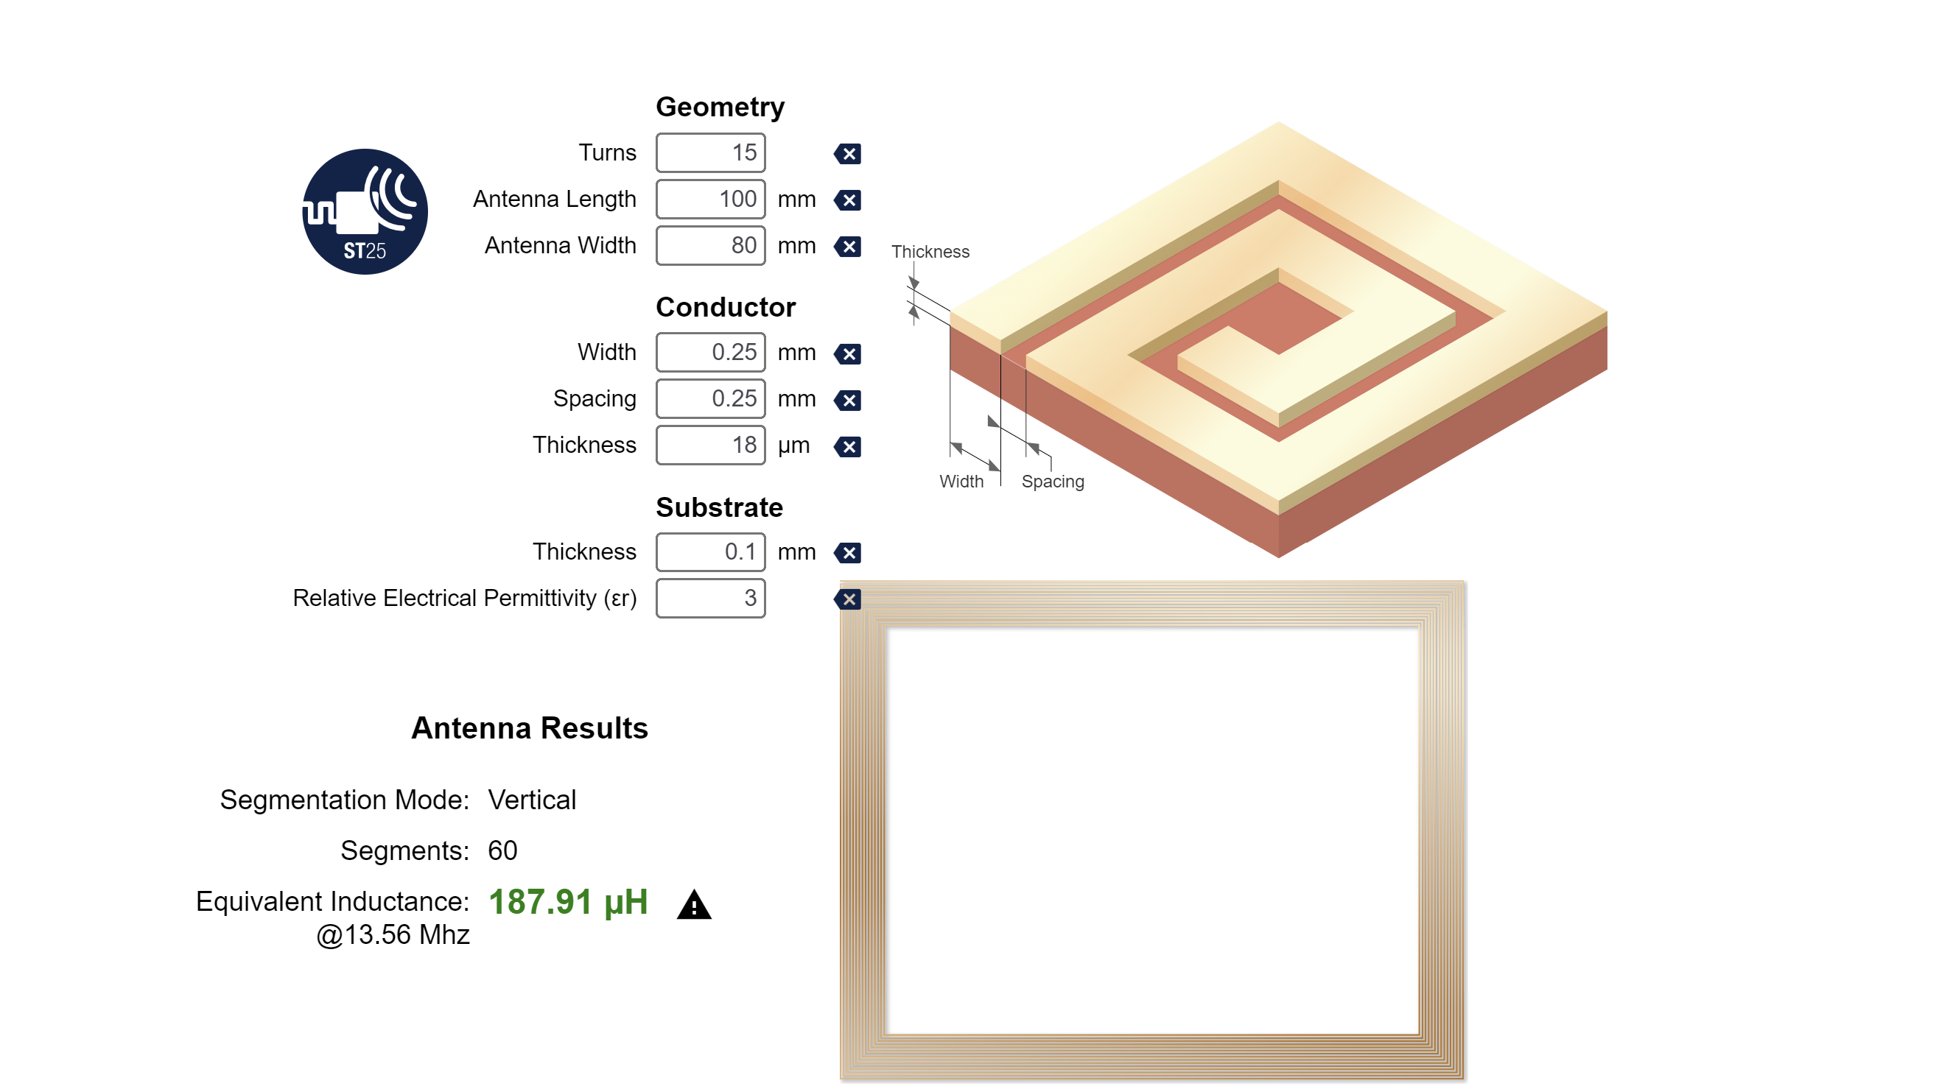
STM Design suite

Slide 7
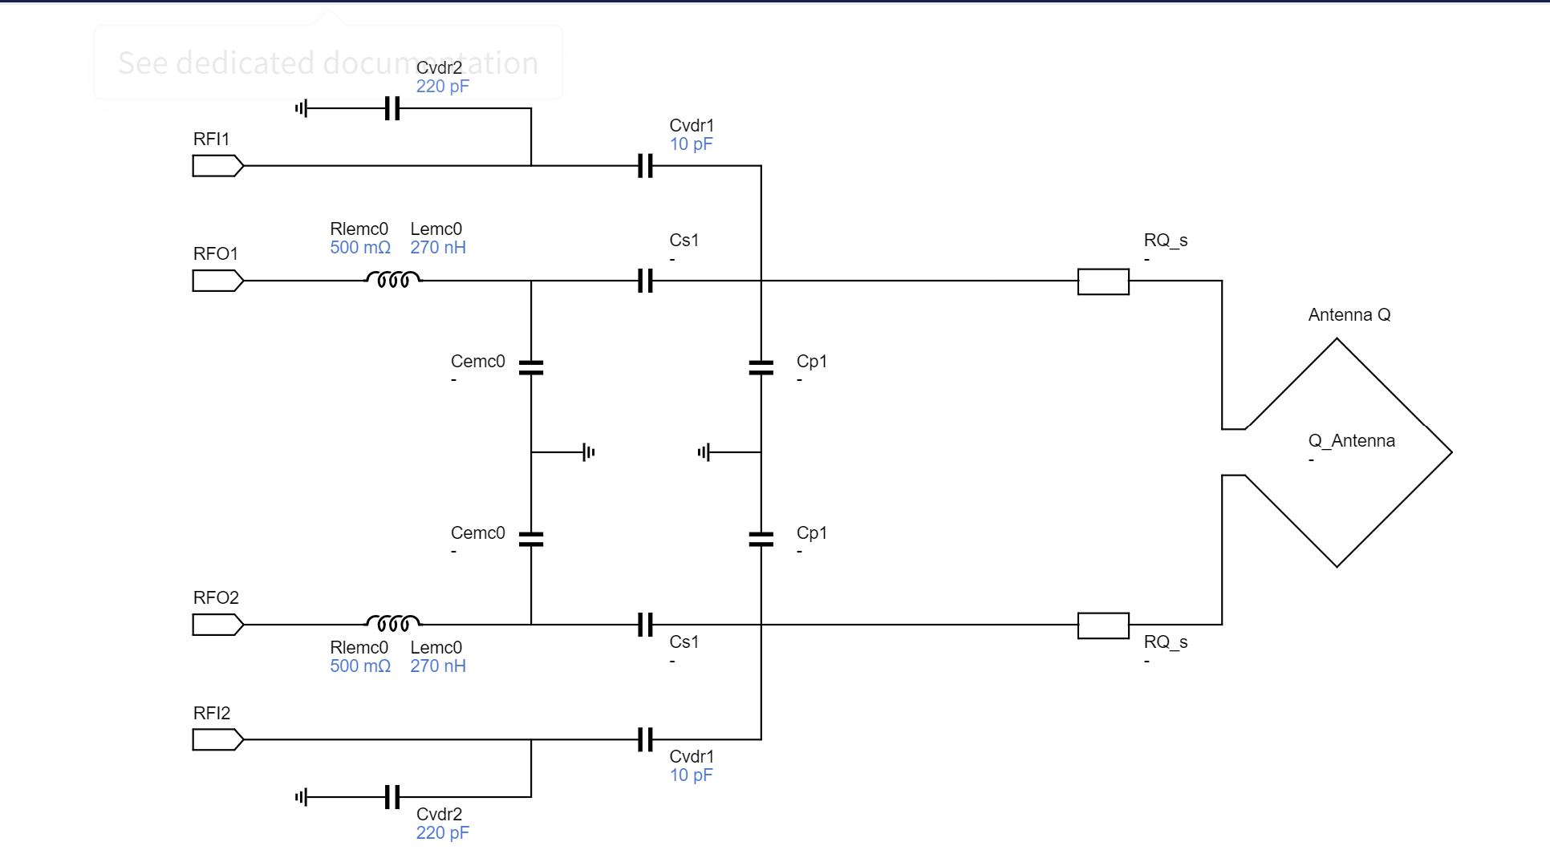
Matching circuit

Slide 8
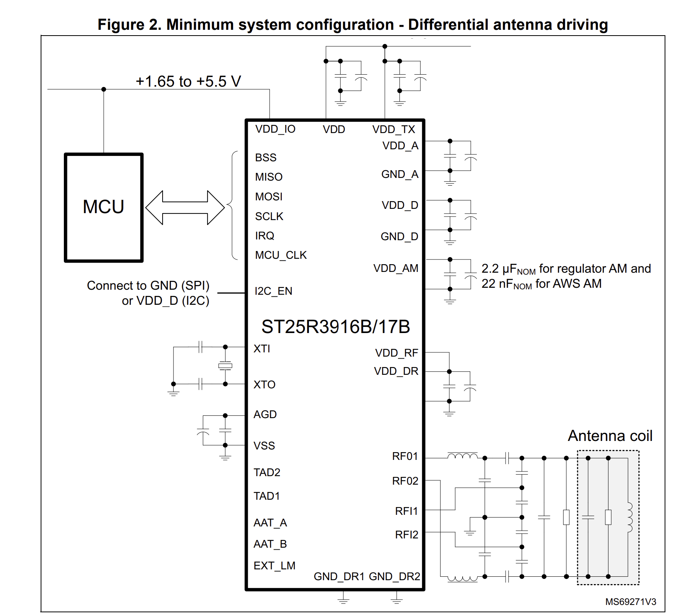
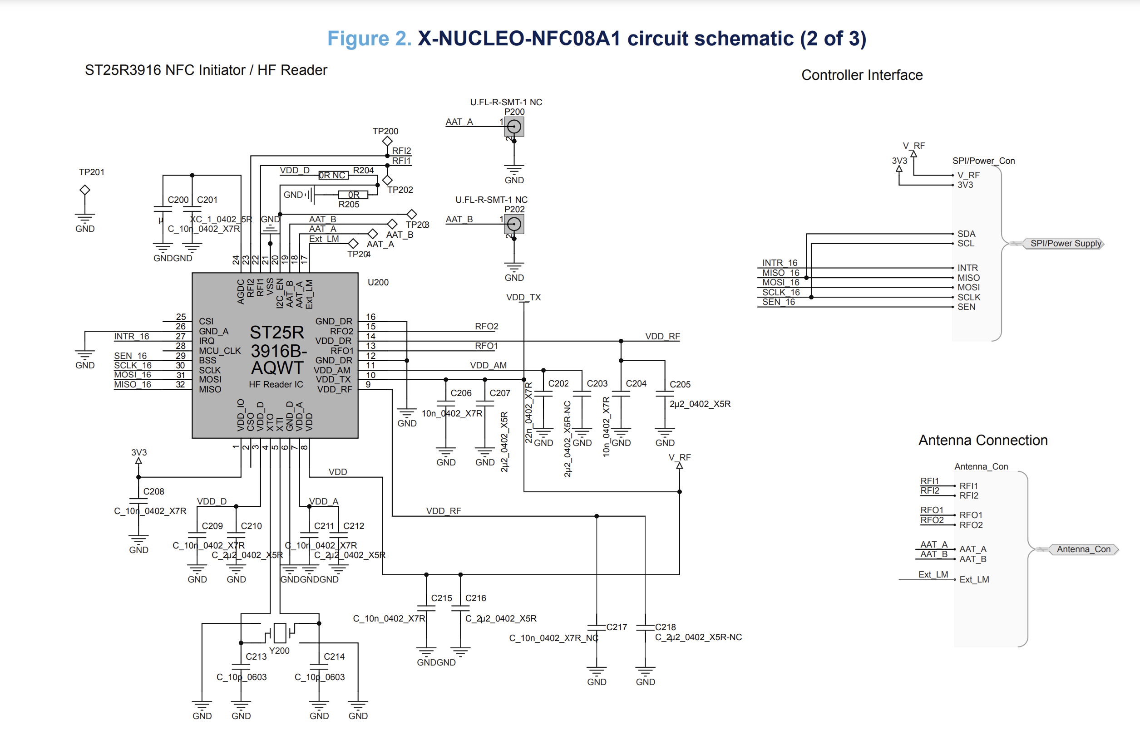
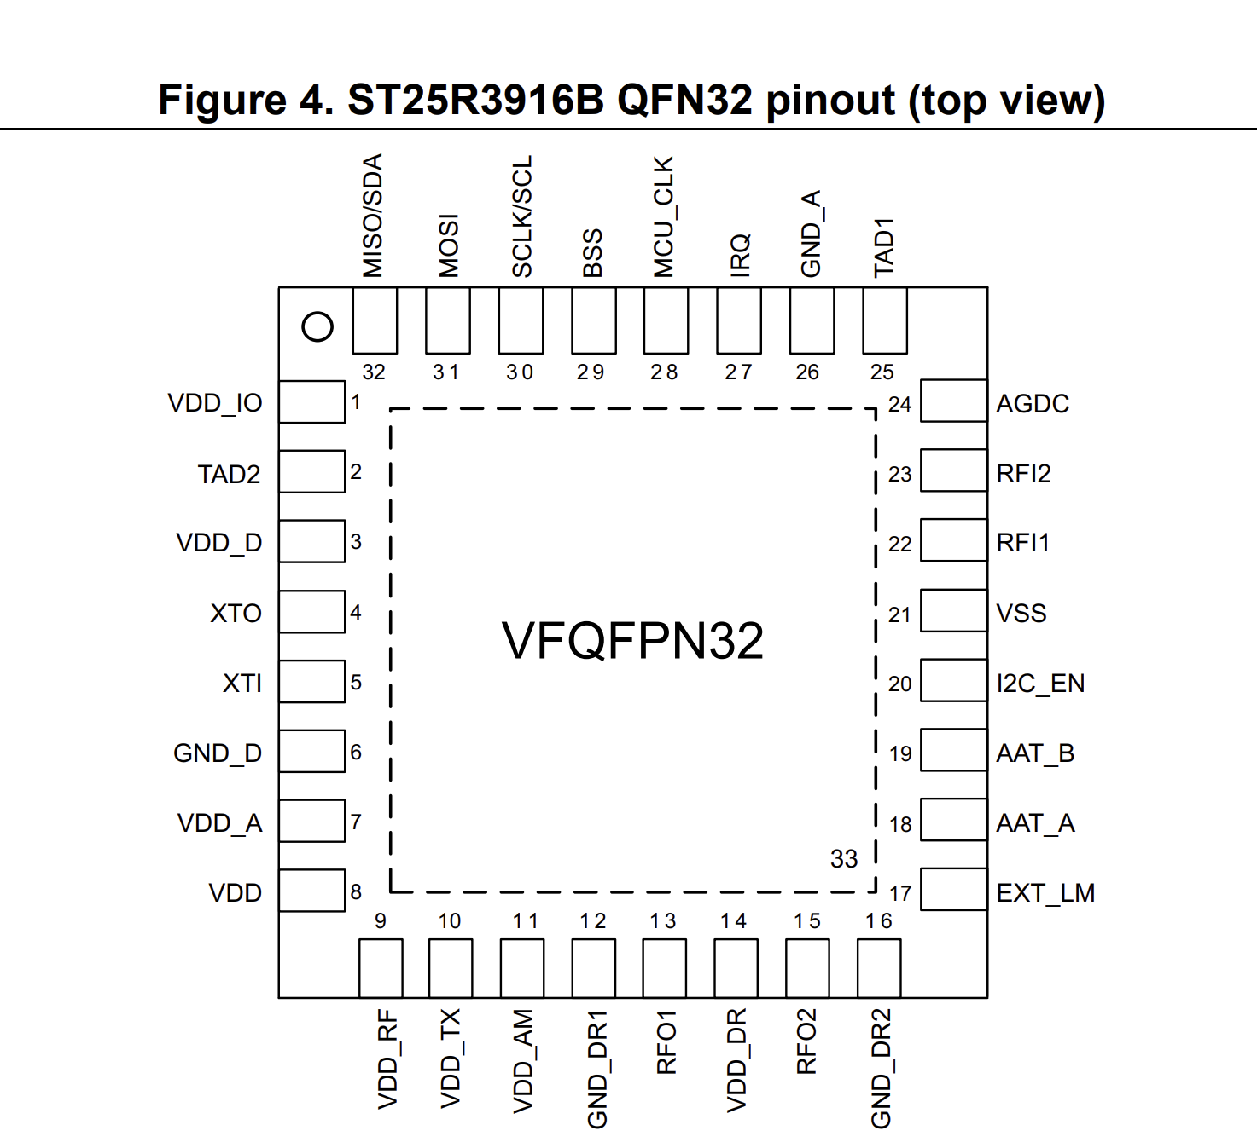

Slide 9
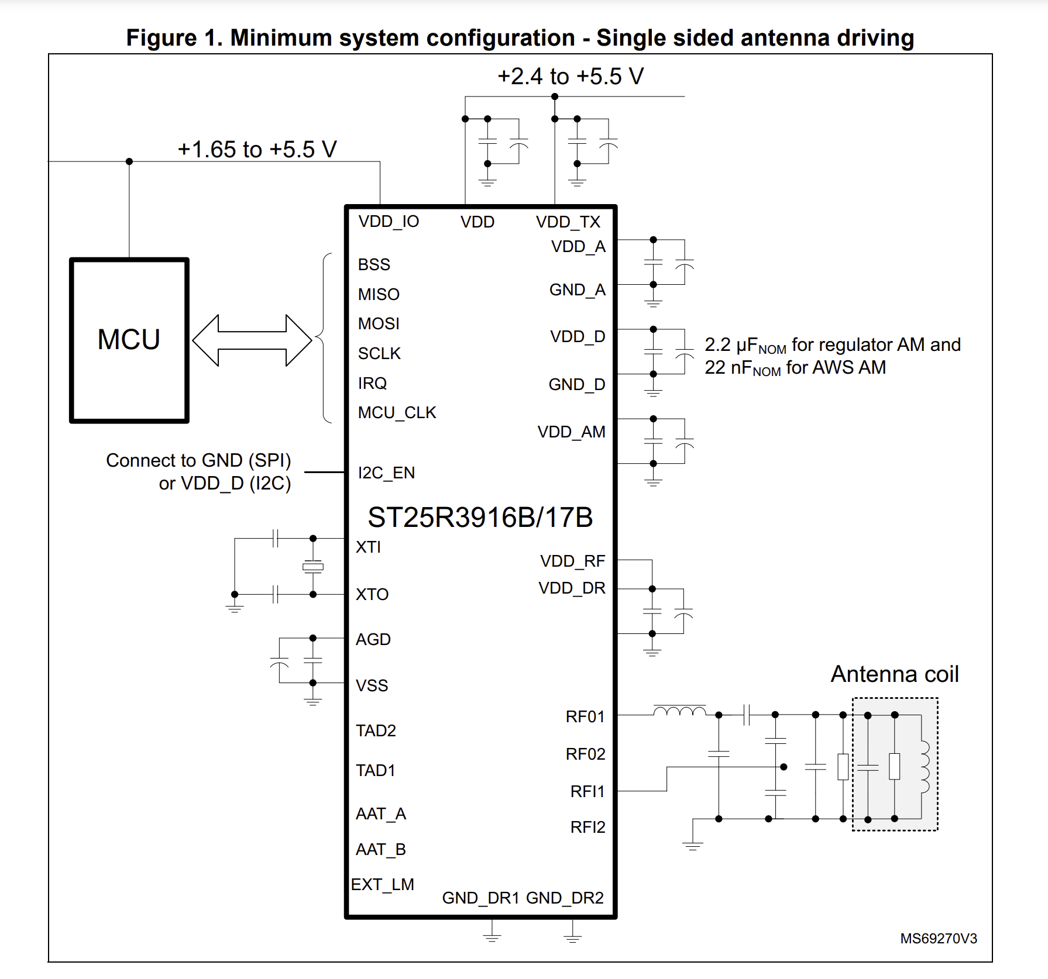
https://www.mouser.com/datasheet/2/389/st25r3916b-2940750.pdf

Slide 12
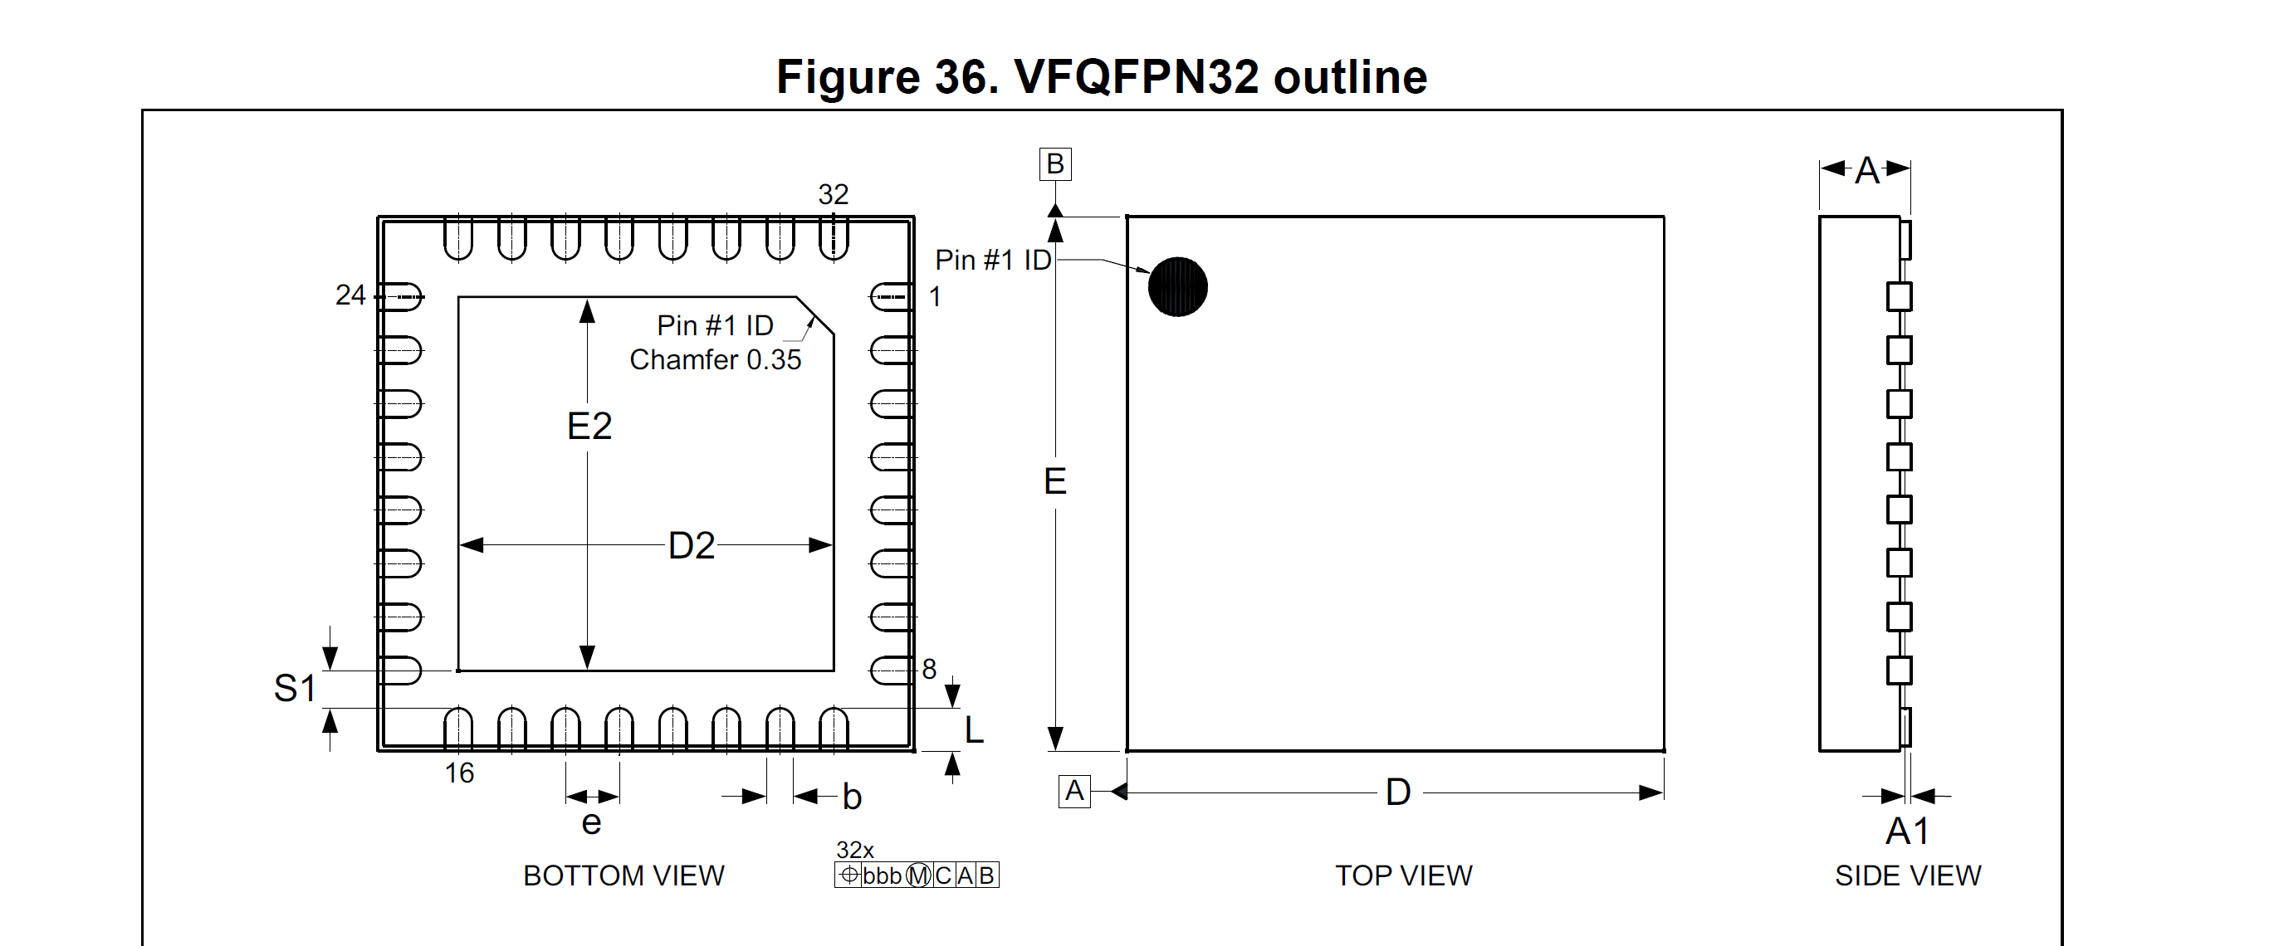
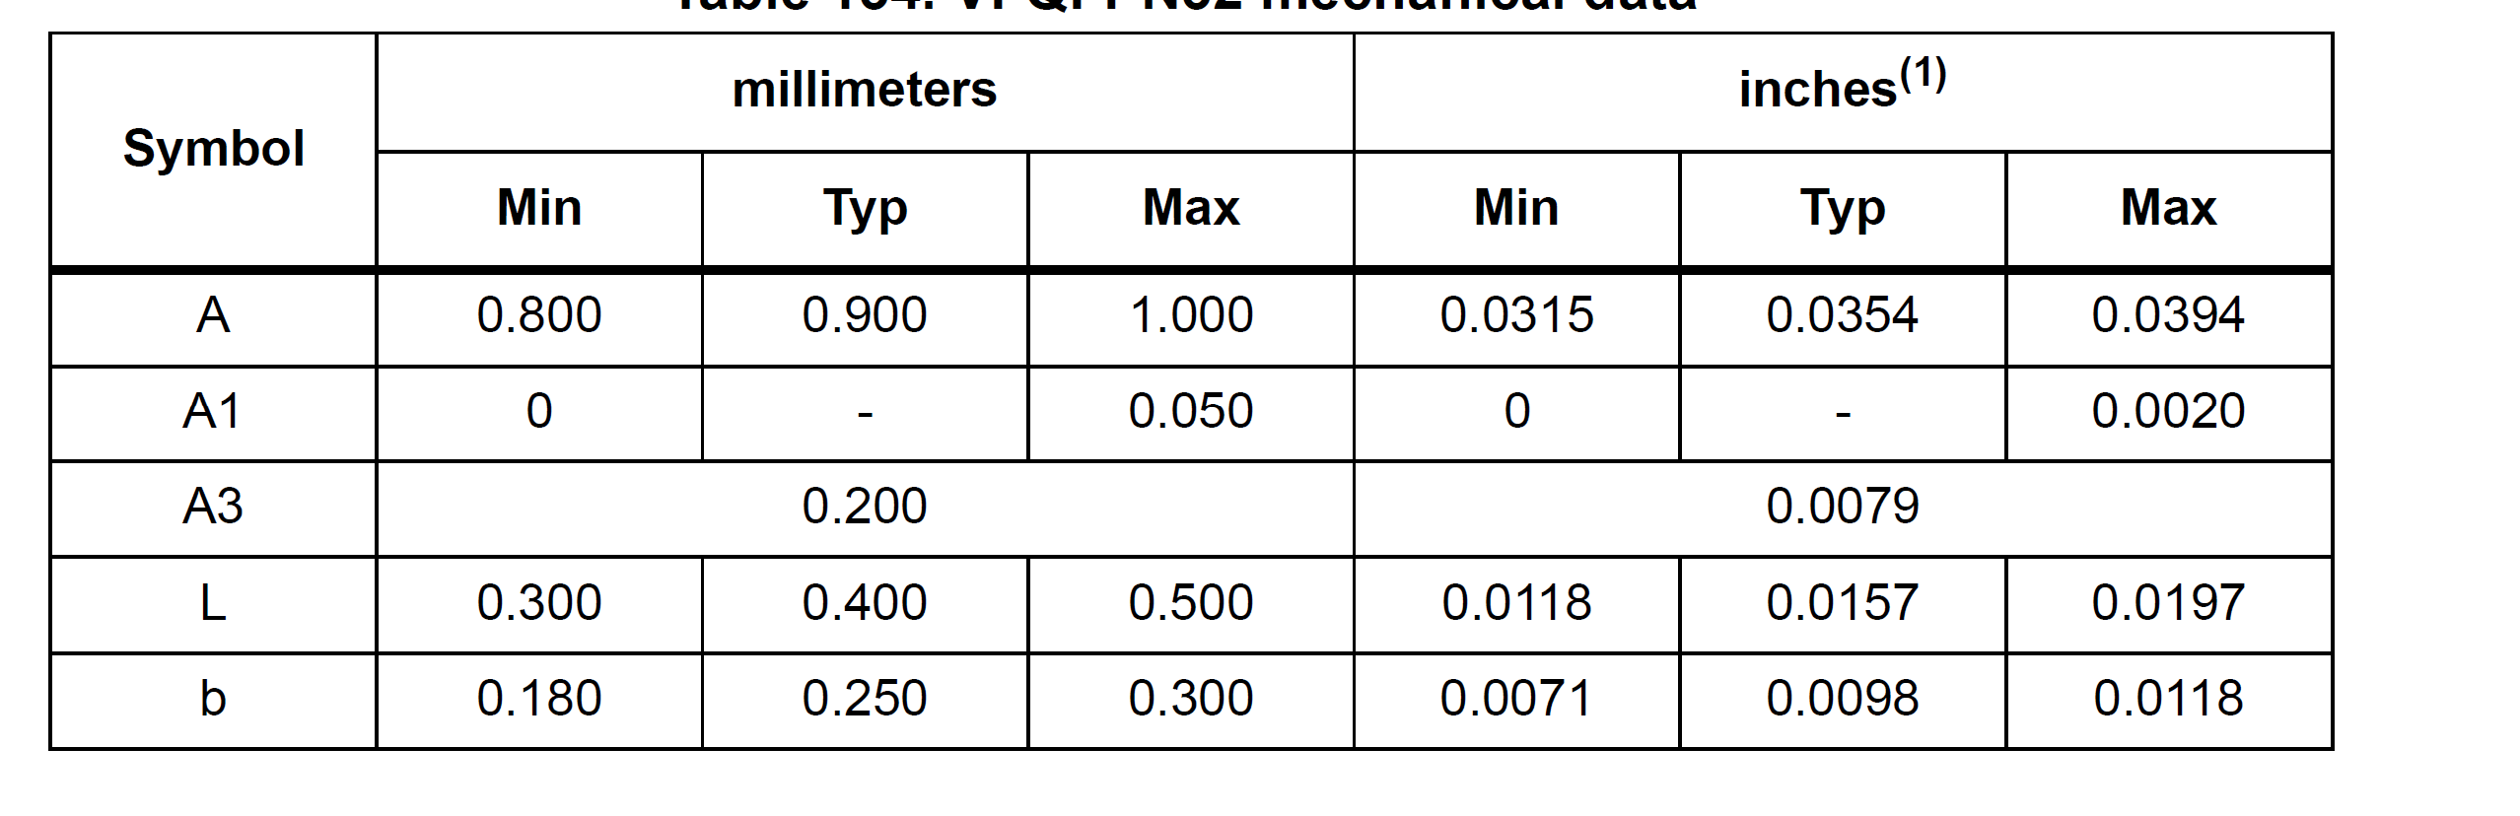
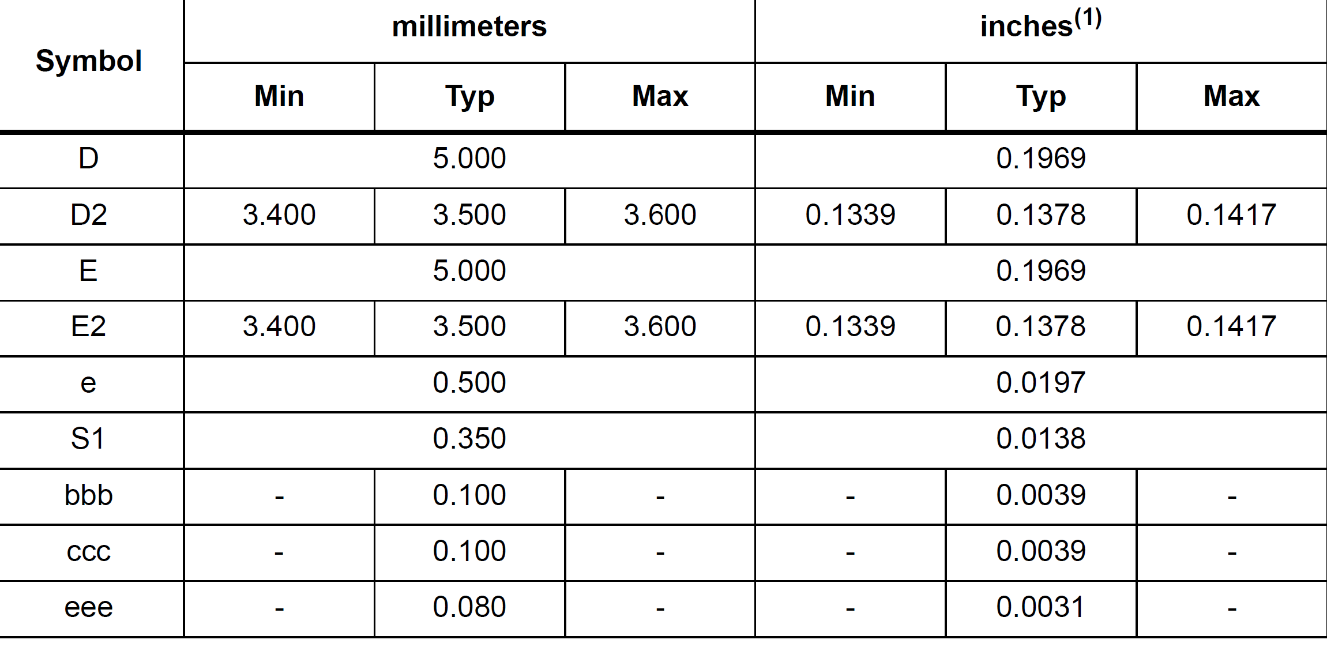
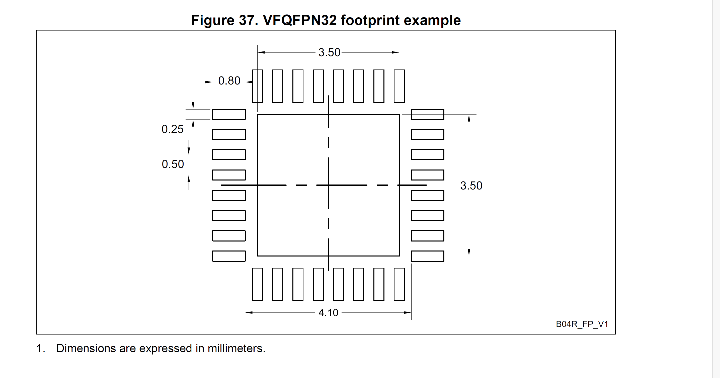
https://www.digikey.com/en/products/detail/stmicroelectronics/ST25R3916-AQWT/9826054?utm_adgroup=General&utm_source=google&utm_medium=cpc&utm_campaign=PMax%20Shopping_Product_Zombie%20SKUs&utm_term=&utm_content=General&utm_id=go_cmp-17815035045_adg-_ad-__dev-c_ext-_prd-9826054_sig-Cj0KCQjwpompBhDZARIsAFD_Fp8BTvC9CbcmB_fXXBJ1jIqcwMShoEnhtZtpH4ASR3gUT2K5HrSSFPkaAiiKEALw_wcB&gad_source=1&gclid=Cj0KCQjwpompBhDZARIsAFD_Fp8BTvC9CbcmB_fXXBJ1jIqcwMShoEnhtZtpH4ASR3gUT2K5HrSSFPkaAiiKEALw_wcB

Slide 13
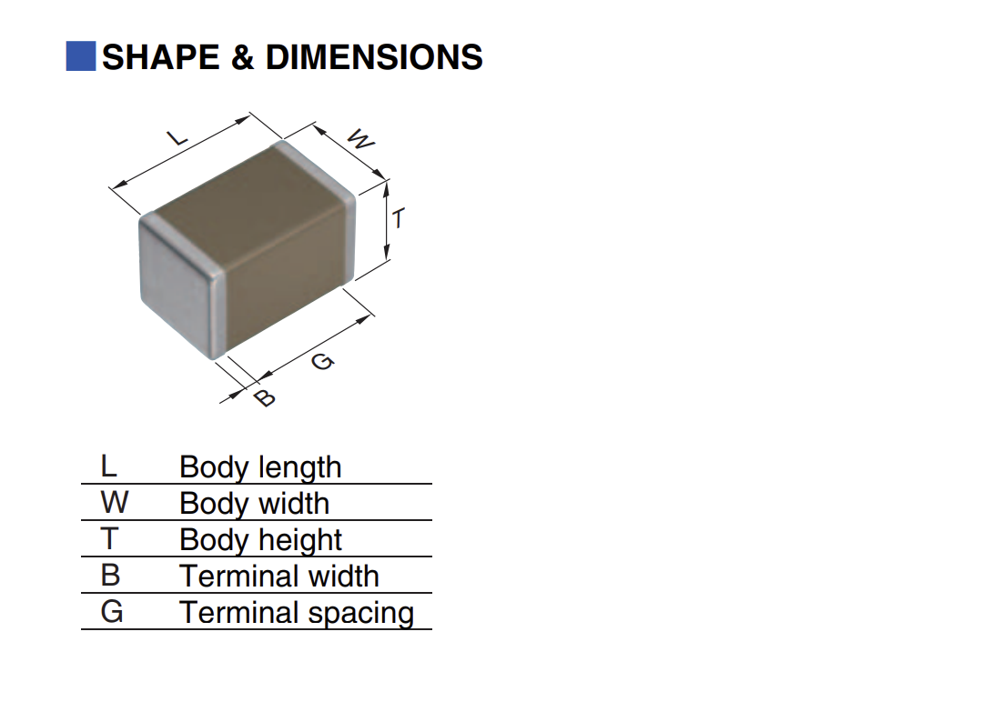
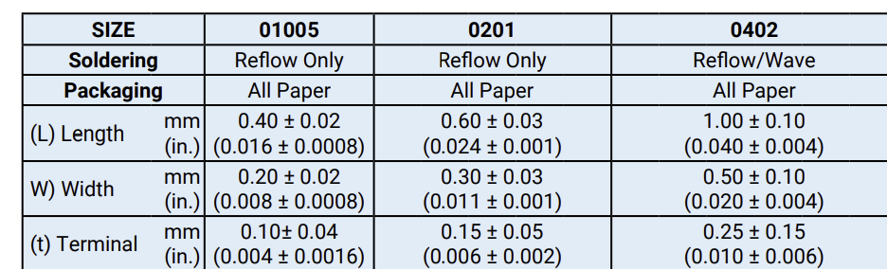

2.2 uF

Slide 14
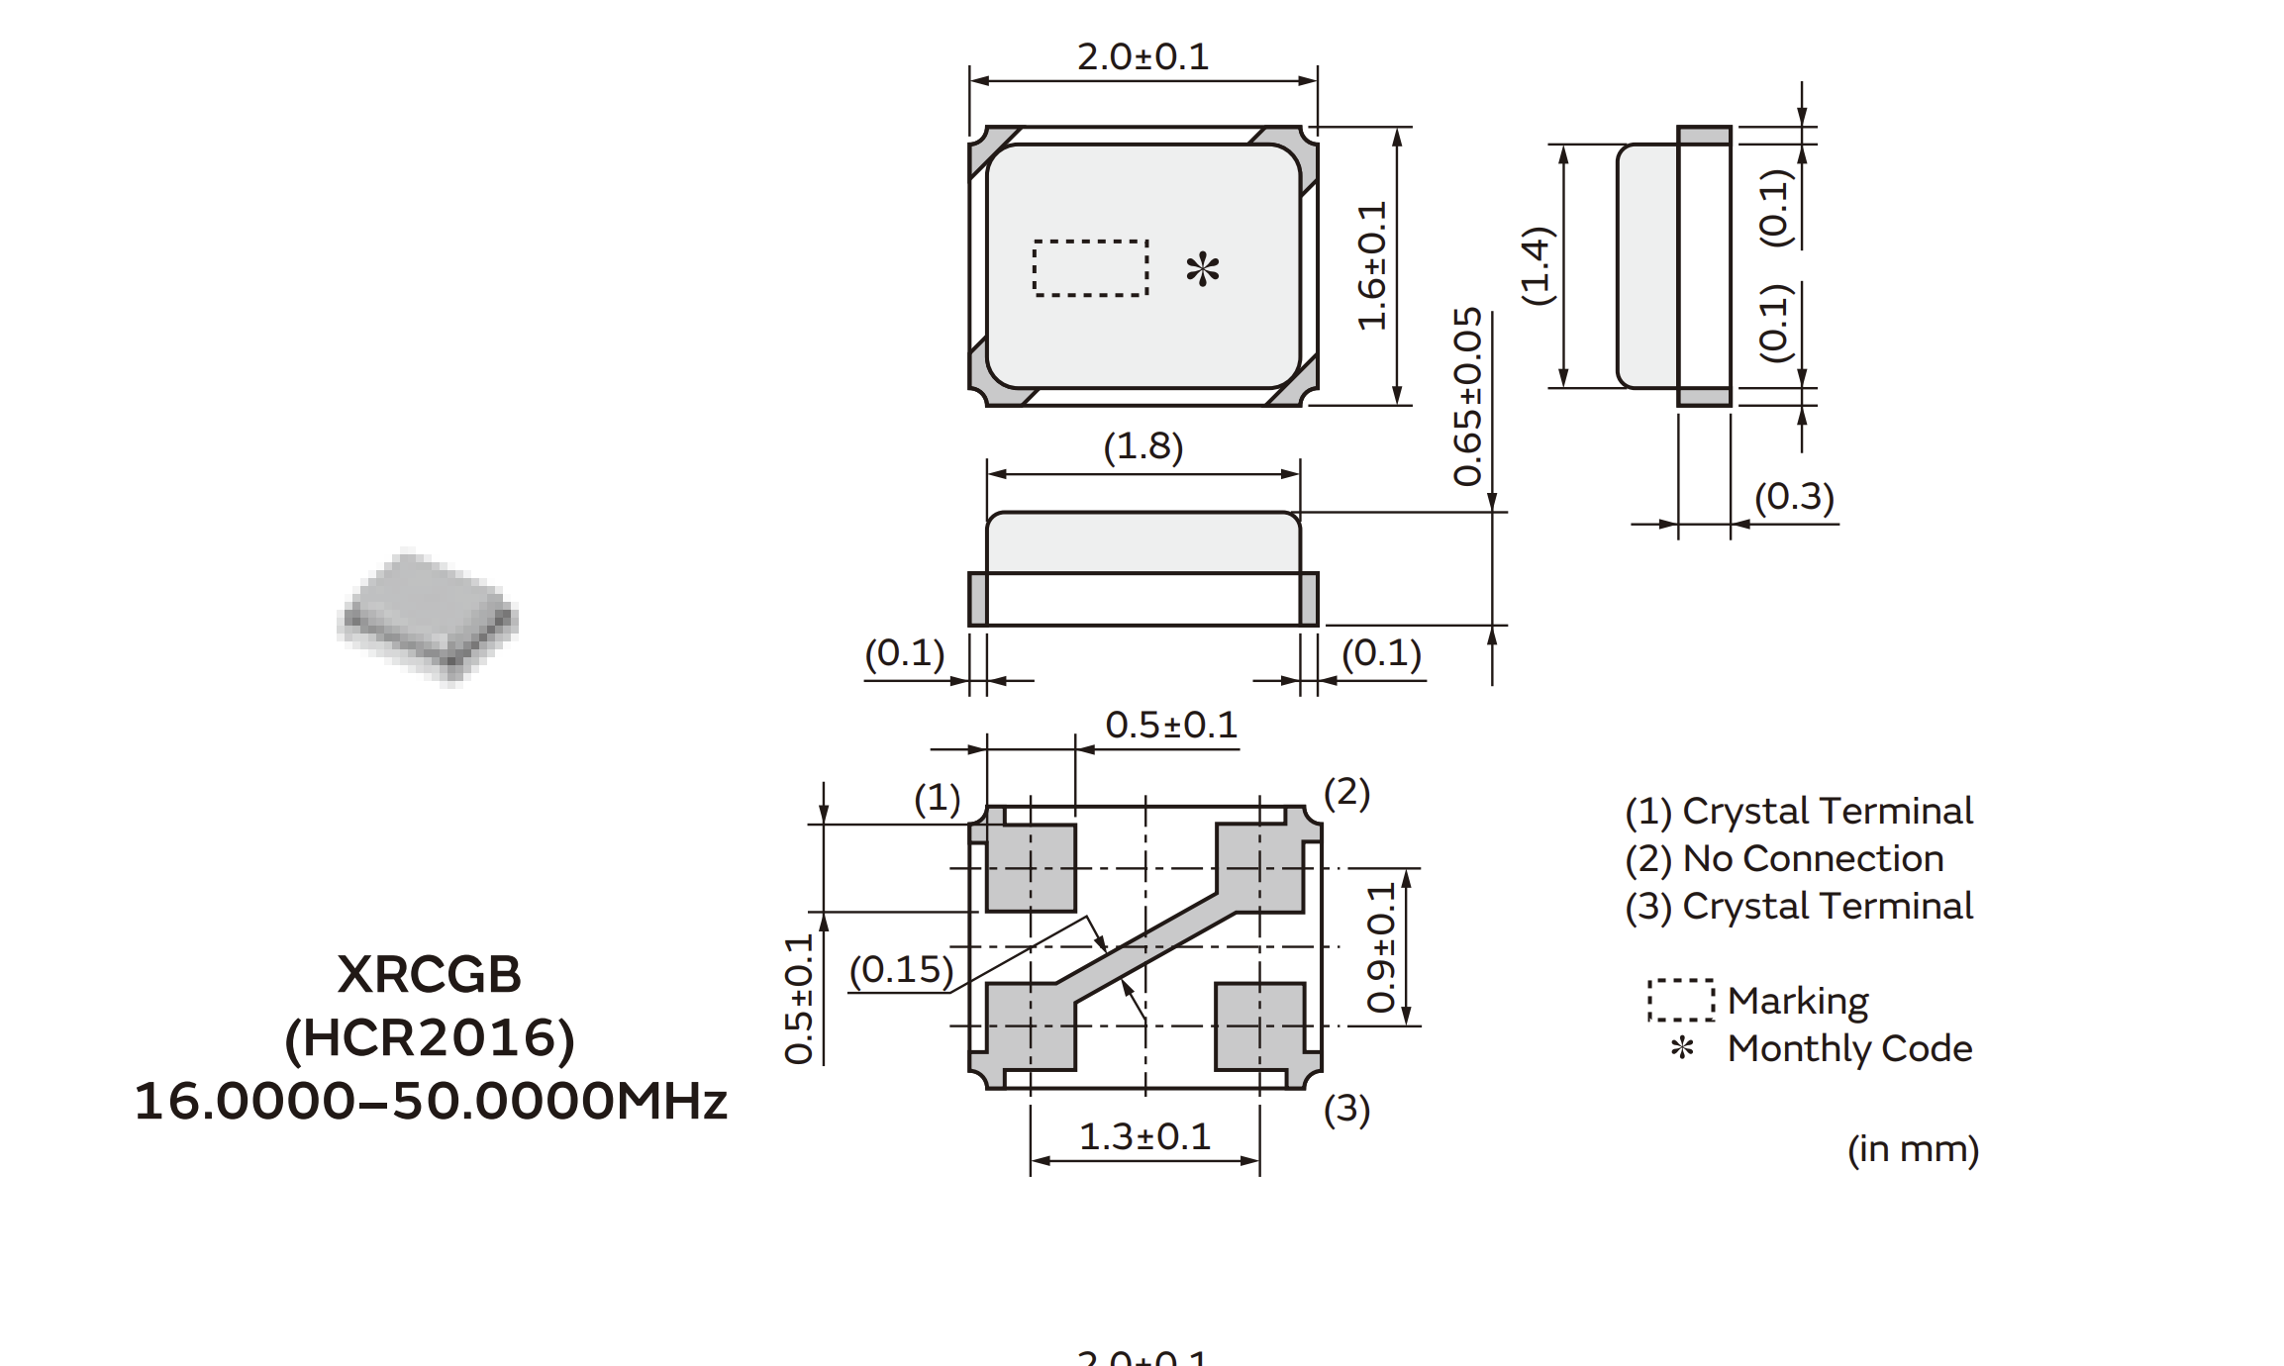
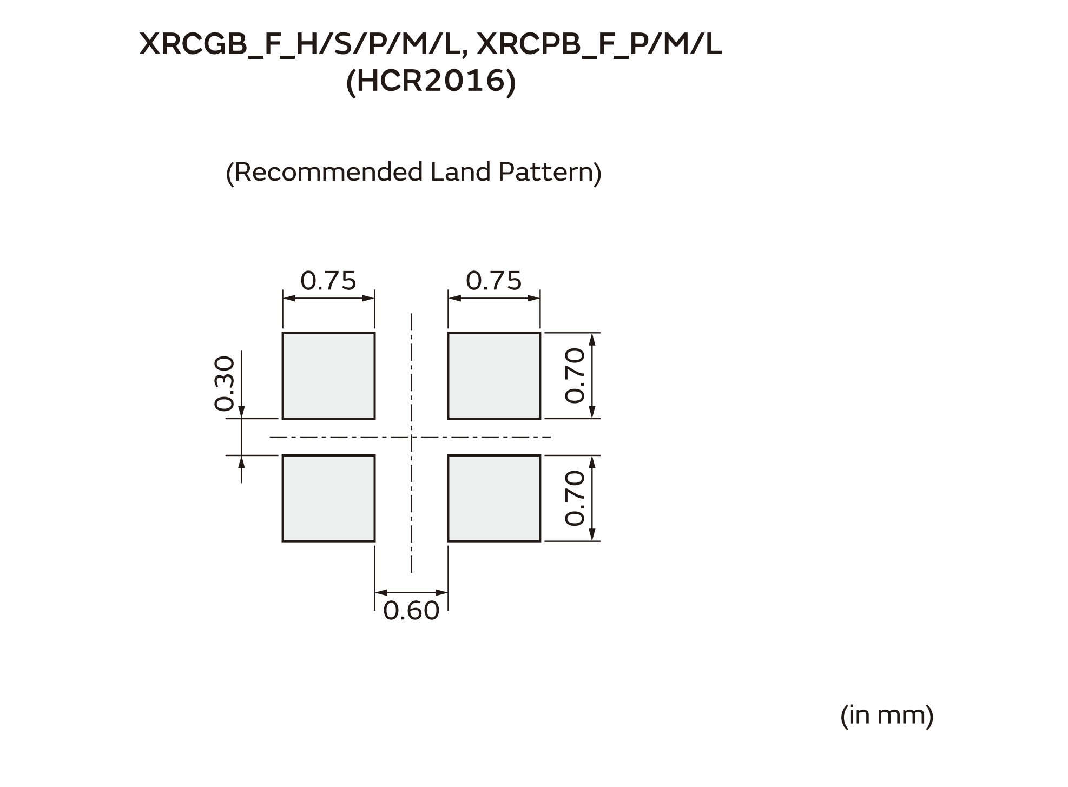
https://www.mouser.com/ProductDetail/Murata-Electronics/XRCGB27M120F3M00R0?qs=e%252BE4OD6MgMfl8qhJDYq%252BAg%3D%3D&gad_source=1&gclid=CjwKCAjwvrOpBhBdEiwAR58-3K2zpguMprPp1FOqZURyJp_-8QgKuY8mZGbG9fD0x5rVRaZs1ZO8uRoCaXcQAvD_BwE

Slide 15
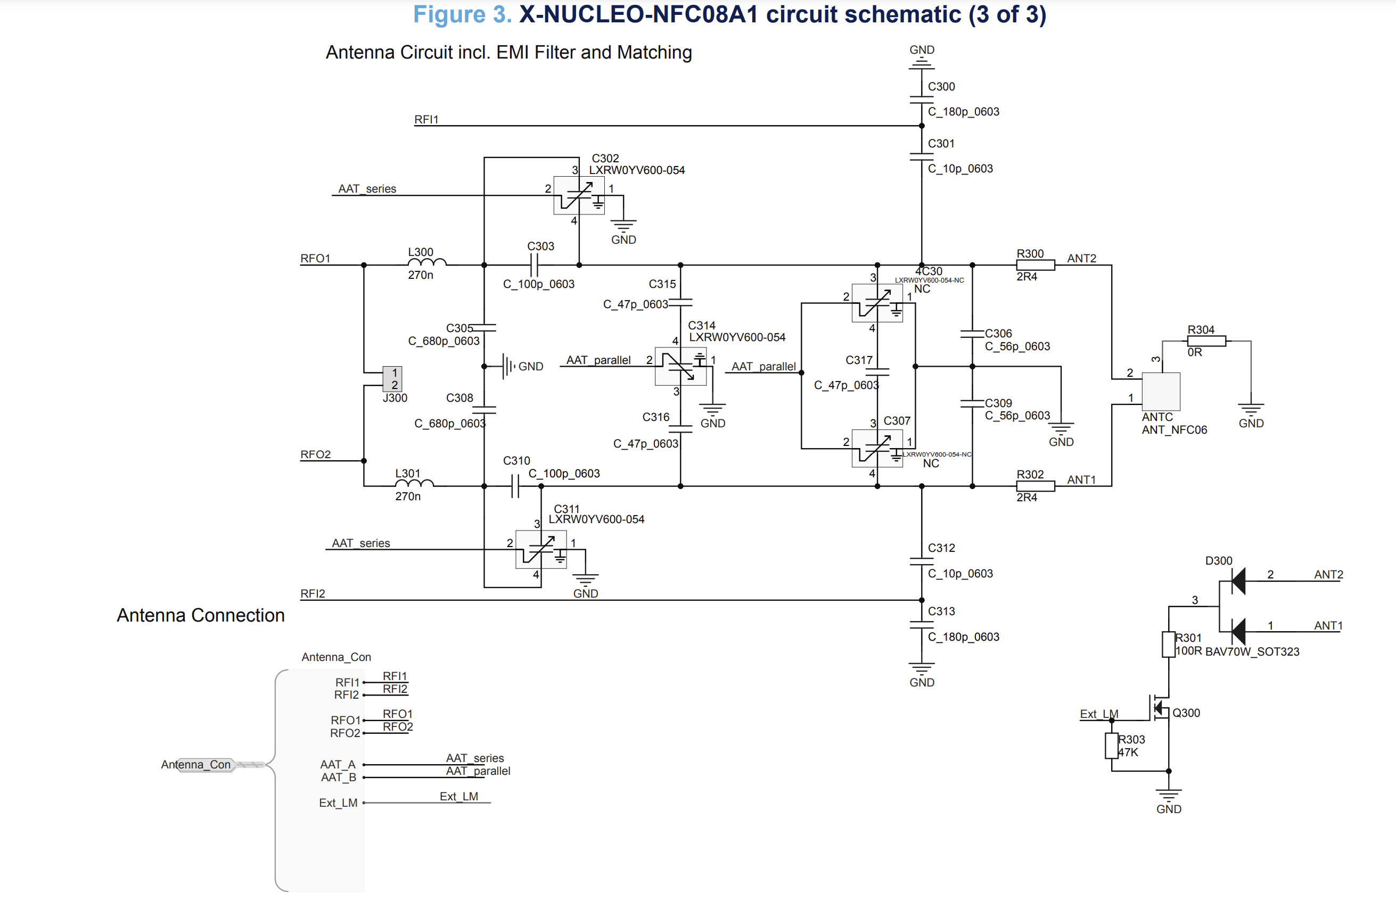

Slide 16
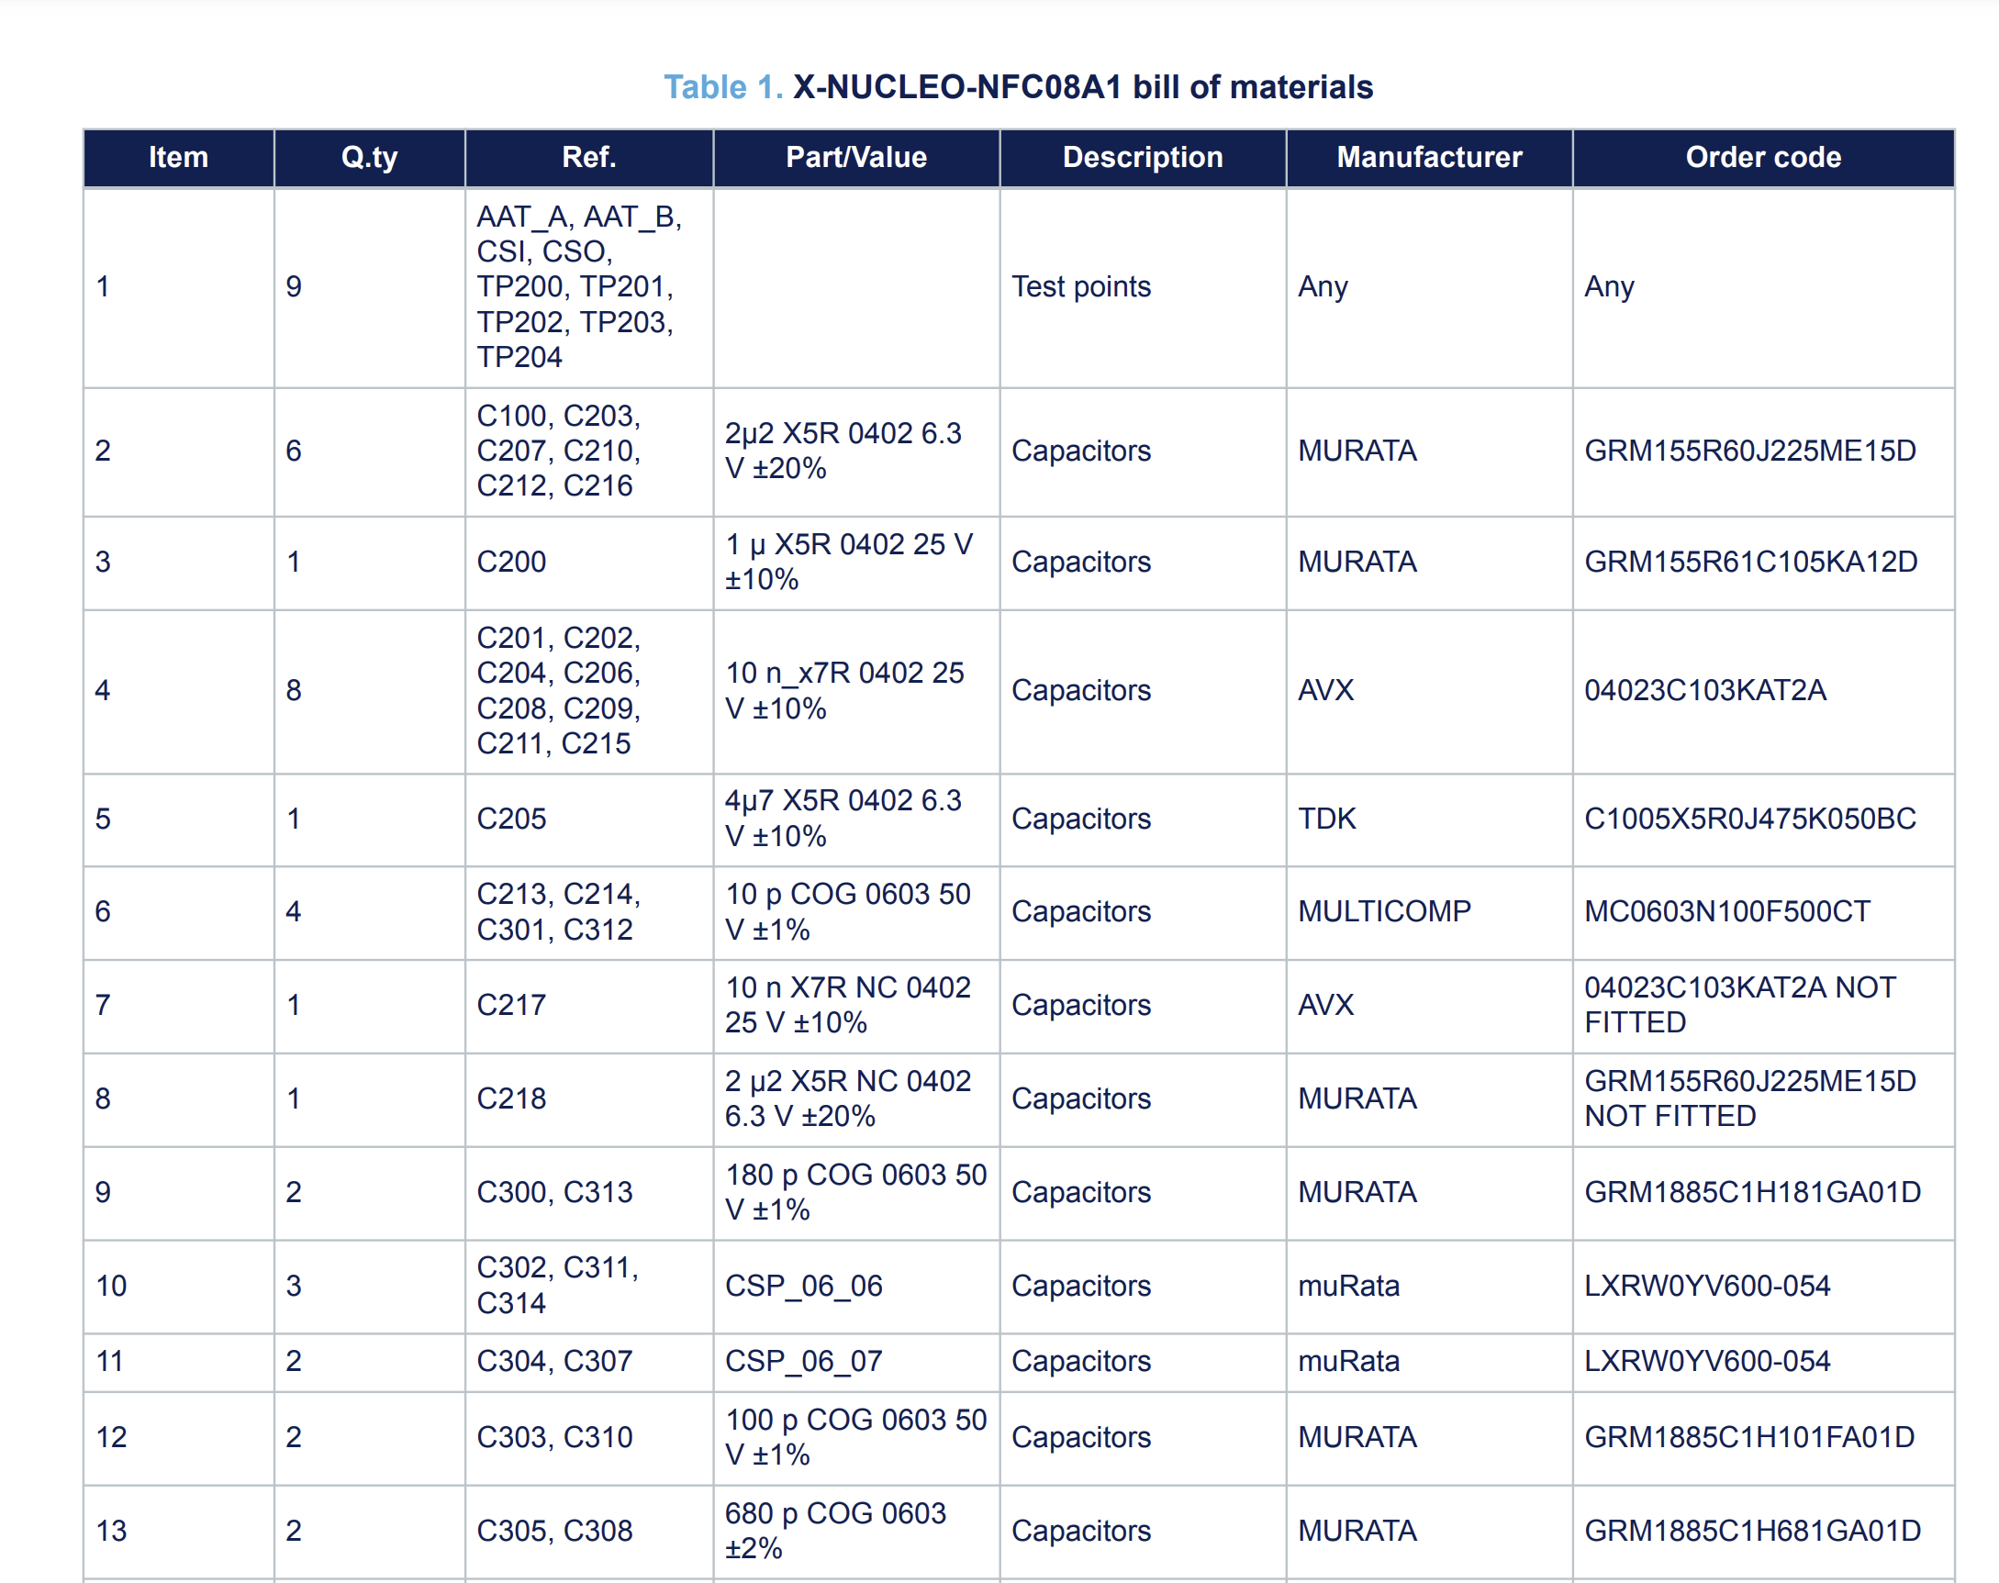

Slide 17
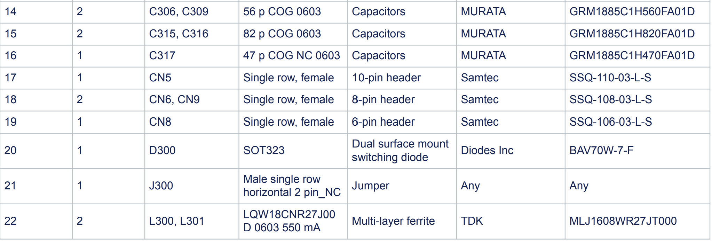

Slide 18
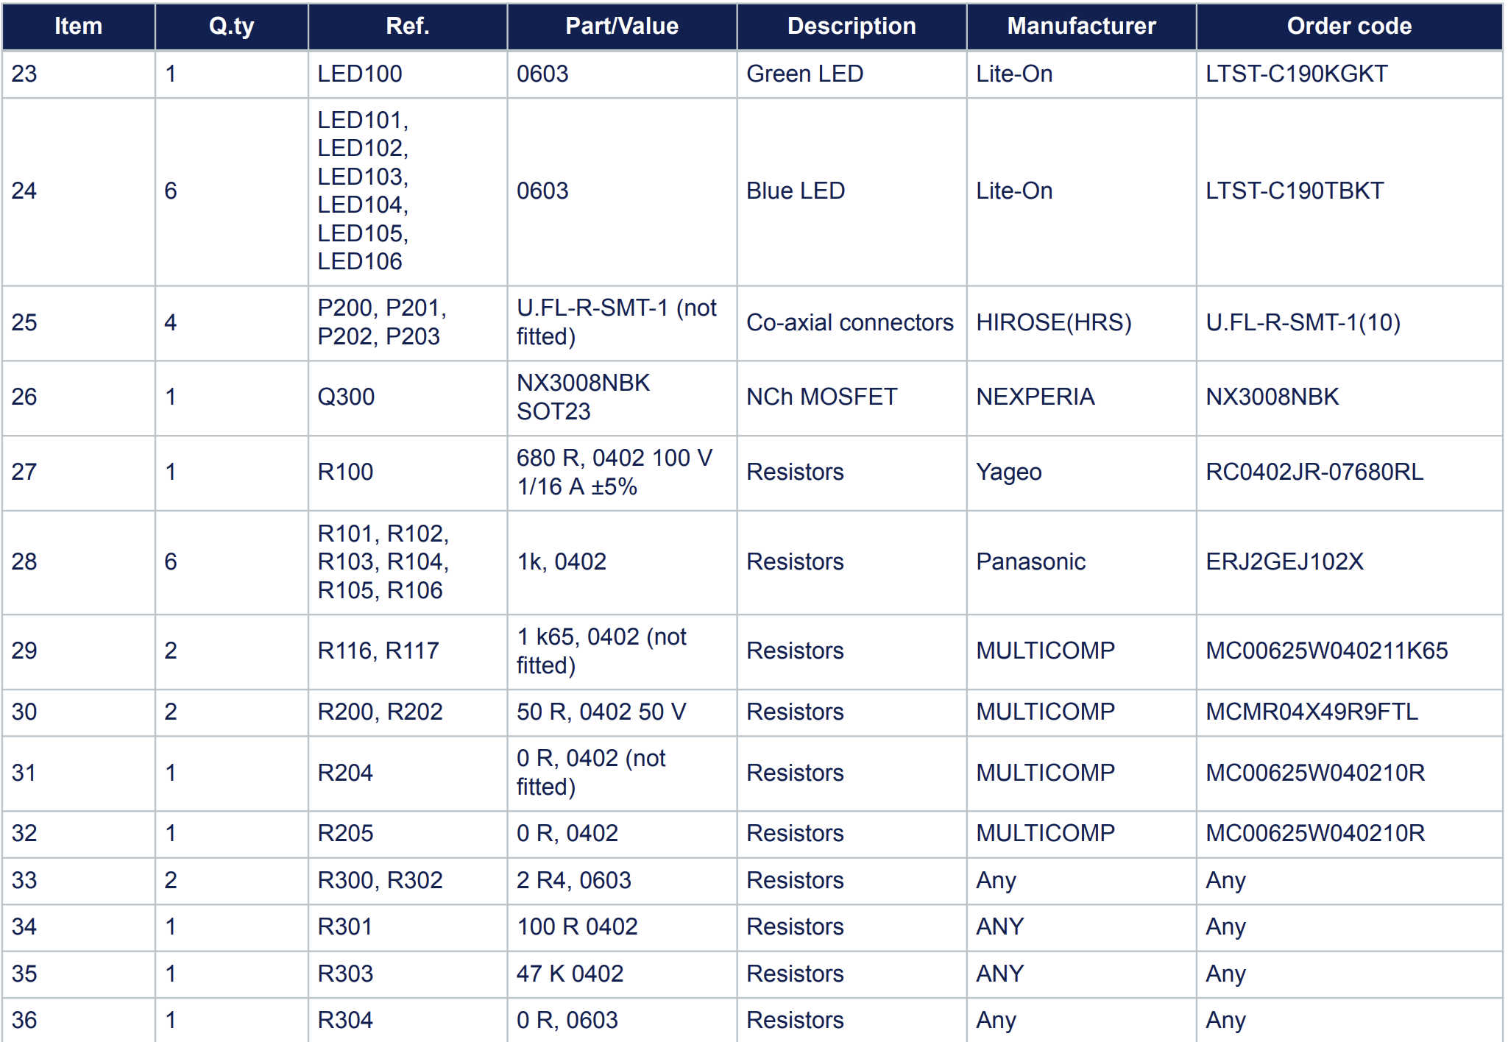

Slide 19
